Slide 1
jQuery Traversing and Searching
Selva kumar S
Assistant Professor, Department of CS&E
selva.cse@bmsce.ac.in

Slide 2
What is jQuery?
jQuery is a fast and concise JavaScript Library that simplifies HTML document traversing, event handling, animating, and Ajax interactions for rapid web development. (jQuery.com)

Slide 3
Why learn jQuery?
Write less, do more:
$("p.neat").addClass("ohmy").show("slow");
Performance
Plugins
It’s standard
… and fun!

Slide 4
Demo URL
http://www.tutorialrepublic.com/jquery-tutorial/jquery-traversing-ancestors.php
http://www.mkyong.com/jquery/jquery-find-example/
http://www.mkyong.com/jquery/jquery-filter-example/
http://www.mkyong.com/jquery/jquery-next-example/
http://www.mkyong.com/jquery/difference-between-find-and-children-in-jquery/
http://www.mkyong.com/jquery/difference-between-filter-and-find-in-jquery/
https://jqueryui.com/autocomplete/
http://www.htmlnest.com/jquery/tutorial/manipulation/jQuery-Replace-Element?eix=270
http://www.htmlnest.com/jquery/tutorial/traversing/jQuery-DOM-Traversing-and-locating-elements?eix=267
http://blog.comperiosearch.com/wp-content/uploads/2012/06/instantsearch.html
http://resource.grapii.com/files/jQueryFilter/divExample.html
http://resource.grapii.com/files/jQueryFilter/ulExample.html?#

Slide 5
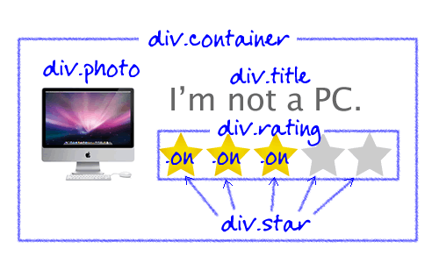
Real-Time application

Slide 6
DOM Traversing
jQuery is a very powerful tool which provides a variety of DOM traversal methods to help us select elements in a document randomly as well as in sequential method.
Most of the DOM Traversal Methods do not modify the jQuery object and they are used to filter out elements from a document based on given conditions.
Traversal methods use to go up, down and all around the DOM tree very easily.

Slide 7
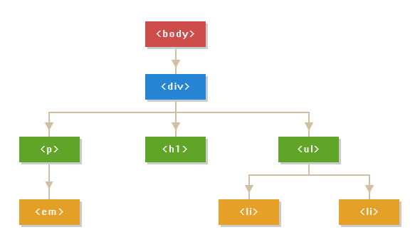
Example : DOM tree
<body>
<div class="container">
<h1>Hello World</h1>
<p>This is a <em>simple paragraph</em>.</p>
<ul>
<li>Item One</li>
<li>Item Two</li>
</ul>
</div>
</body>

Slide 8
Example : DOM tree
The <body> element is the parent of the <div> element, and an ancestor of everything inside of it. The enclosed <div> element is the parent of <h1>, <p> and <ul> elements, and a child of the <body> element.
The elements <h1>, <p> and <ul> are siblings, since they share the same parent.
The <h1> element is a child of the <div> element and a descendant of the <body> element. This element does not have any children.
The <p> element is the parent of <em> element, child of the <div> element and adescendant of the <body> element. The containing <em> element is a child of this <p>element and a descendant of the <div> and <body> element.

Slide 9
Traversing up the DOM Tree
jQuery provides the useful methods such used to traverse up in the DOM tree either single or multiple levels to easily get the parent or other ancestors of an element in the hierarchy.
parent()
parents() and
parentsUntil()

Slide 10
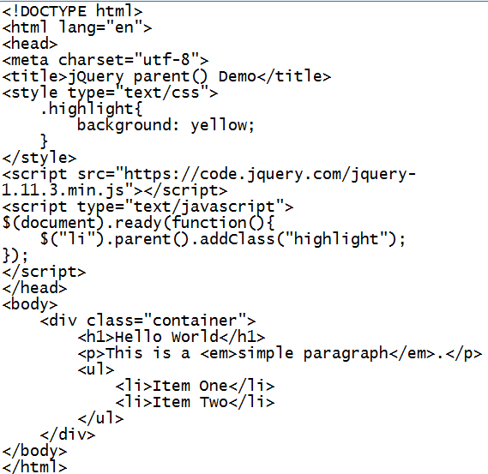
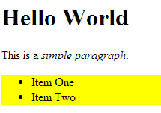
jQuery parent() Method
http://www.tutorialrepublic.com/jquery-tutorial/jquery-traversing-ancestors.php

Slide 11
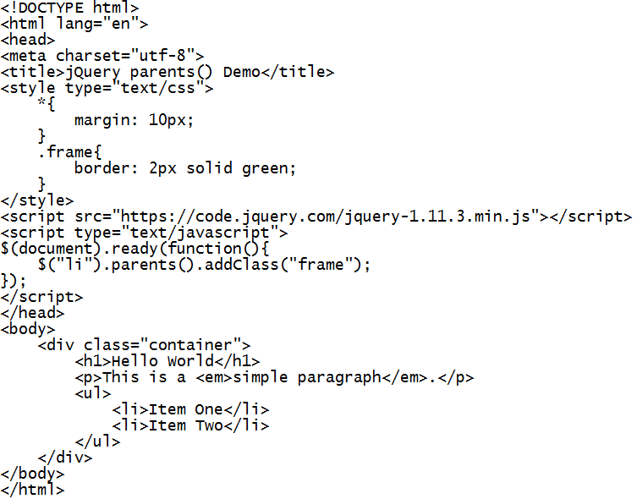
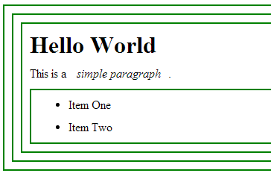
jQuery parents() Method

Slide 12
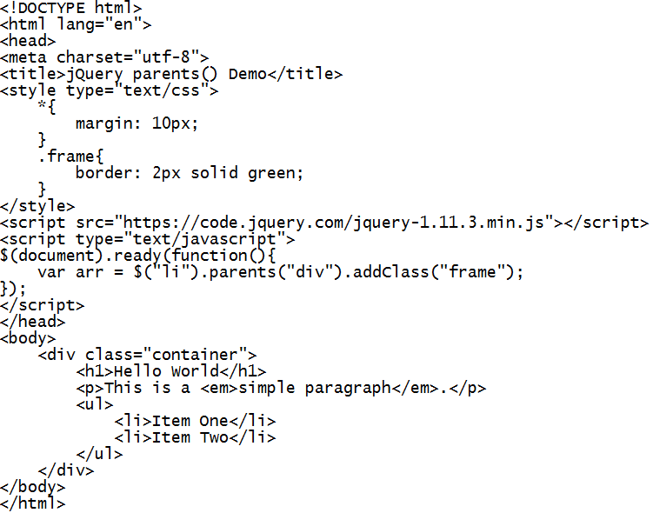
Guess the Output??

Slide 13
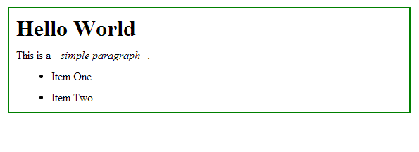

Slide 14
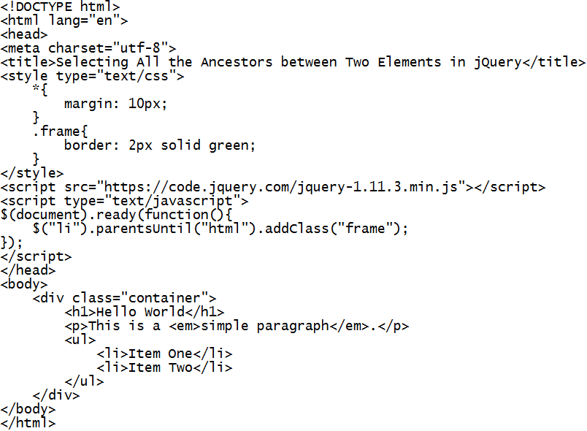
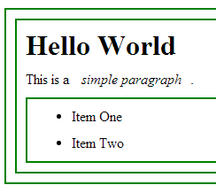
jQuery parentsUntil() Method

Slide 15
Traversing Down the DOM Tree
jQuery provides the useful methods such used to traverse down in the DOM tree either single or multiple levels to easily find or get the child or other descendants of an element in the hierarchy.
children() and
find()

Slide 16
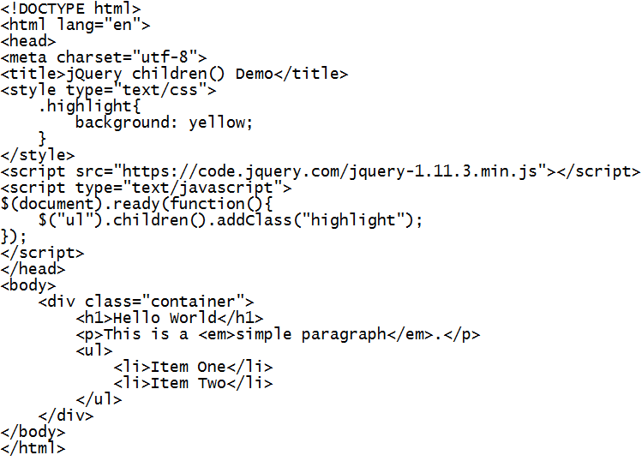
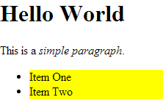
jQuery children() Method

Slide 17
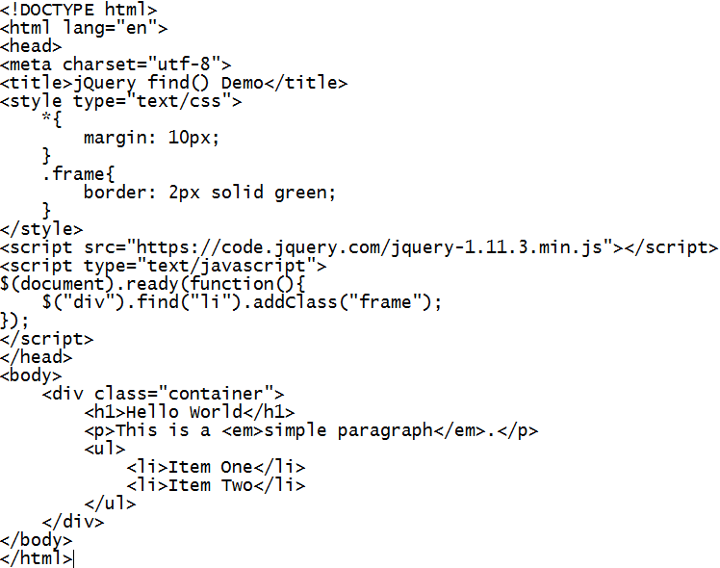
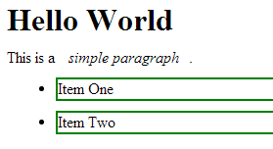
jQuery find() Method

Slide 18
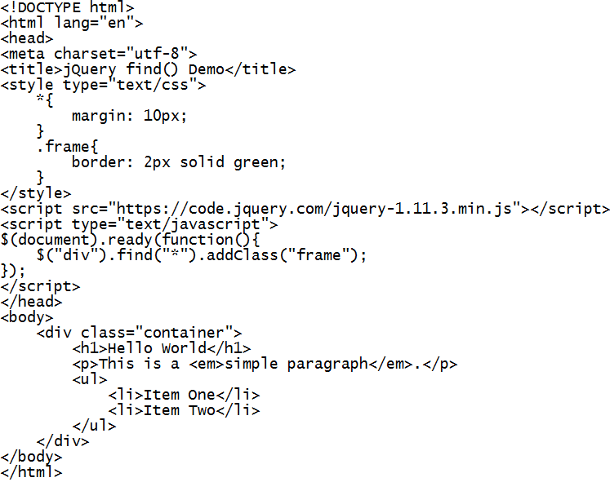
Guess the Output?

Slide 19
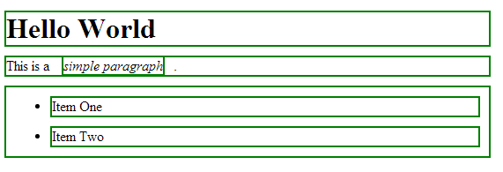

Slide 20
Traversing Sideways in DOM Tree
jQuery provides several methods used to traverse sideways in the DOM tree.
siblings()
next()
nextAll()
nextUntil()
prev()
prevAll() and
prevUntil()

Slide 21

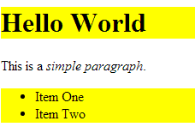
jQuery siblings() Method

Slide 22
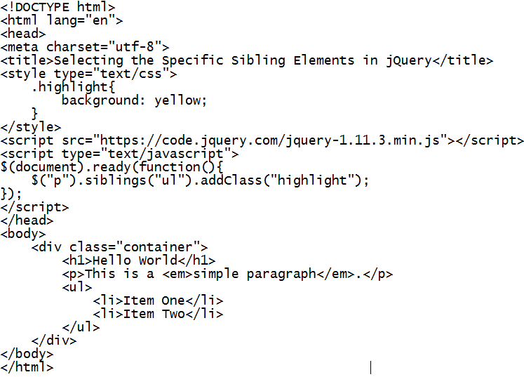
Guess the Output?

Slide 23
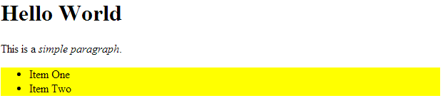

Slide 24
Filtering the Elements Selection
jQuery provides several methods use to narrow down the search for elements in a DOM tree.
filter()
first()
last()
eq()
slice()
has()
not() etc.

Slide 25
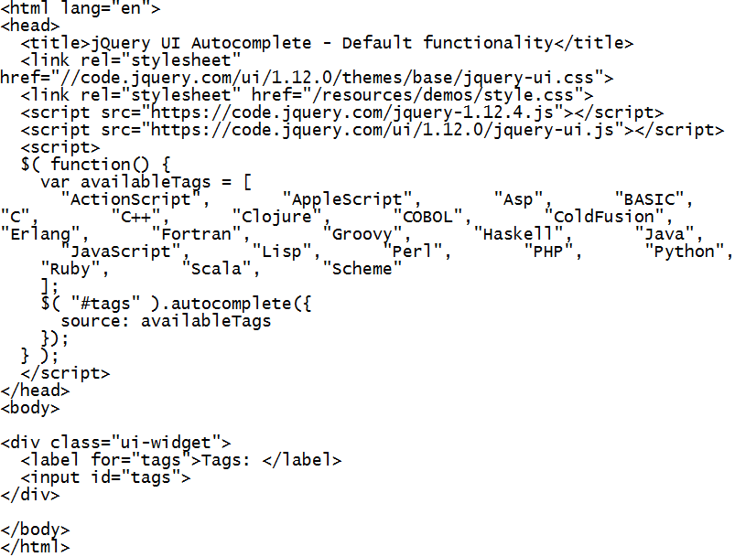
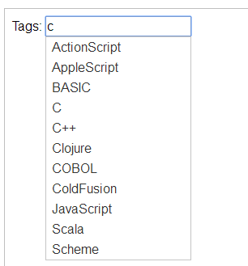
Autocomplete

Slide 26
Further Study
www.tutorialpoint.com
www.tutorialrepublic.com

